Slide 1
WG Changing Ocean Climate and Ocean Acidifcation WG COCOA
Bee Berx (UK) and Jos Schilder (NL)
ICG ORED – 23 January 2024

Slide 2
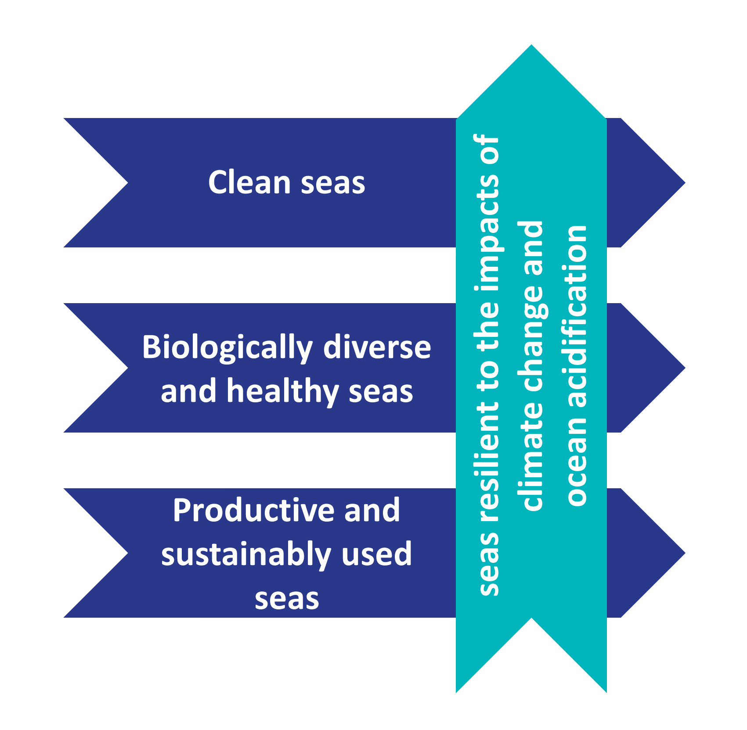
Increasing emphasis on OA and CC
ICG Ocean Acidification
Since 2018
Focus on delivering OA monitoring and assessment
Climate Change EG
Since 2021
Established on request from ICG-QSR to CoG
Focus on delivery of CC Thematic Assessment in QSR2023
Propose how to incorporate CC in OSPAR work
ICG OA + CCEG = WG COCOA

Slide 3
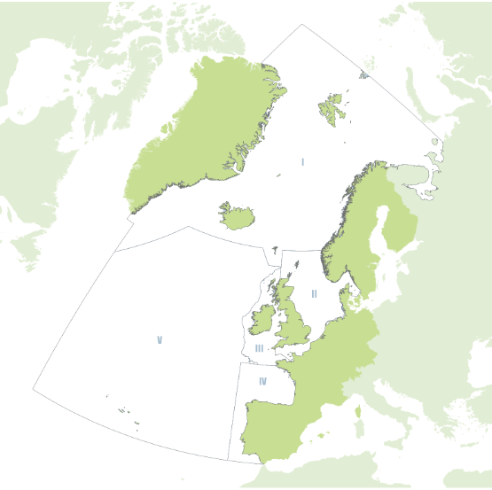
OSPAR CONVENTION (1992) FOR THE PROTECTION OF THE MARINE ENVIRONMENT OF THE NORTH-EAST ATLANTIC
OSPAR Maritime Area
OSPAR Vision (2030 Strategy)
A clean, healthy and biologically diverse North-East Atlantic Ocean, which is productive, used sustainably and resilient to climate change and ocean acidification.
15 Governments and the EU

Slide 4
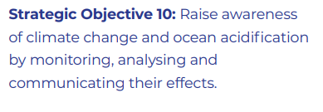
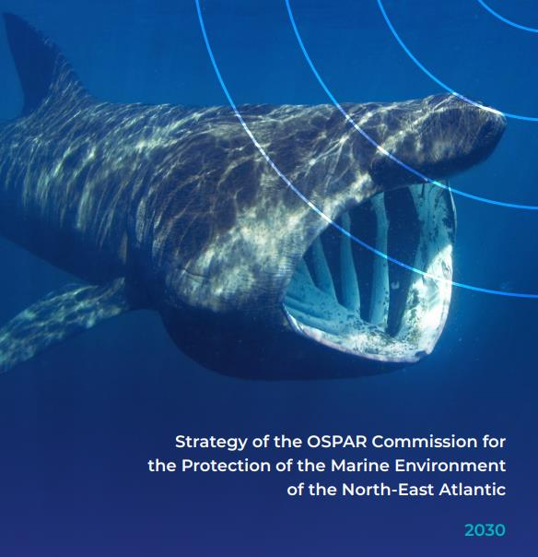
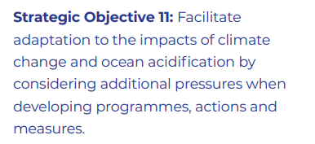
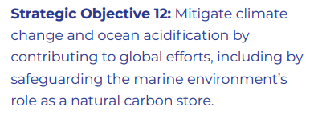
North-East Atlantic Environment Strategy (NEAES) 2030

Slide 5
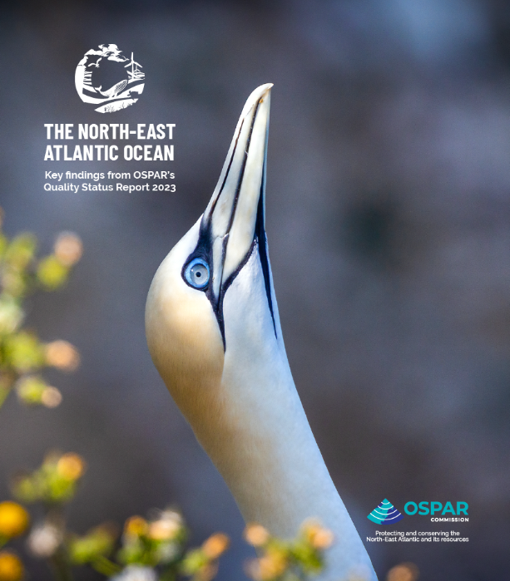
Quality Status Report (QSR) 2023
https://oap.ospar.org/en/ospar-assessments/quality-status-reports/qsr-2023/
The North East Atlantic Ocean Key Findings from OSPARs QSR 2023 (interactive PDF)

Slide 6
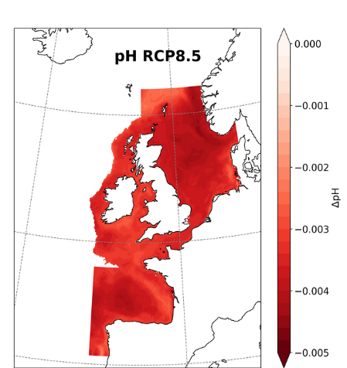
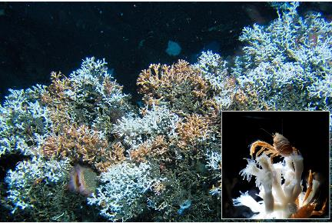
Ocean Acidification Assessment Key messages
Ocean acidification is observed in all regions of the OSPAR Maritime Area
The rate of change varies per region (-0,0011 to -0,033 pH units per year)
Local processes (such as nutrient input and productivity) have strong influence
Ocean acidification is projected to continue under the studied emmission scenarios
An acceleration is projected for the high emission scenario
The sea floor area of deep waters corrosive to calcareous structures is projected to increase significantly
Ocean acidification puts marine life (further) under pressure
OA pressure typically coincides with other pressures (multi-stressor)
Threatened and/or declining species and habitats are particularly vulnerable
Significant economical consequences expected (loss of revenue commercial species)
OA needs to be taken into account when considering climate change adaptation and mitigation
Such measures may alleviate or exacarbate ocean acidification and its impacts
Removing other pressures (pollution, habitat destruction) can increase ecosystem resilience to OA impacts

Slide 7
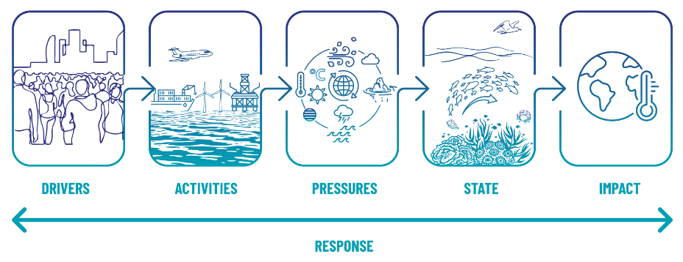
Climate Change & Ocean Acidification in OSPAR QSR 2023

Slide 8
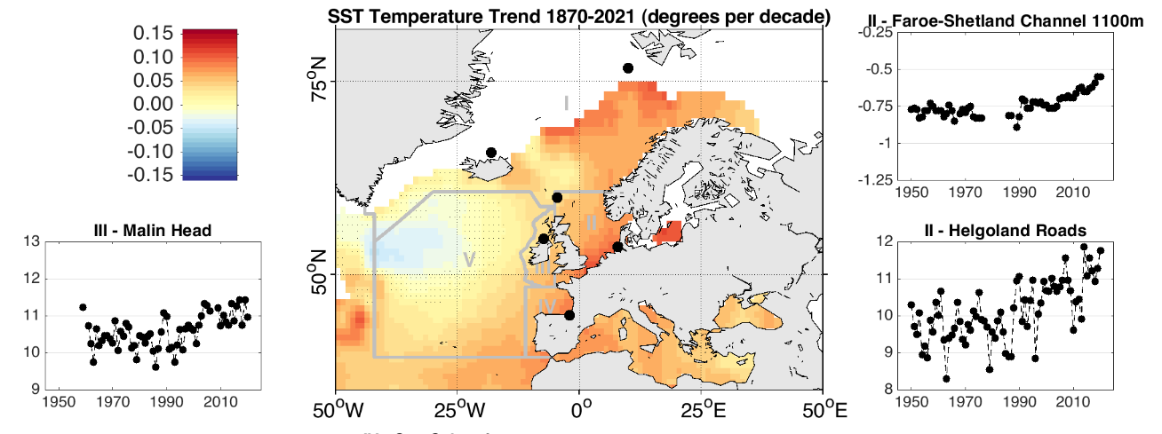
Climate Change & Ocean Acidification in OSPAR QSR 2023
Increased sea temperatures
Reducing sea ice
Increased freshwater input
Changed salinity
Changes in large-scale ocean circulation
Changes in shelf sea stratification
Changes in open ocean stratification
Annual Mean
Temperature (°C)
Annual Mean
Temperature (°C)
Annual Mean
Temperature (°C)
Increased storms and waves
Rising sea level
Reduced uptake of CO₂
Acidification
Nutrient enrichment
Reducing dissolved oxygen
Changes in upwelling intensity
Marine Heatwaves

Slide 9
Climate Change & Ocean Acidification in OSPAR QSR 2023
Changes in state have been reported from across the OSPAR Maritime Area and have been identified across the three non-climate themes in NEAES 2030.
Clean Seas: Marine Litter, Hazardous substances, Radioactive substances, Eutrophication
Biologically Diverse: impacts of climate change on the marine ecosystem, its function and biodiversity. These can generally be categorised as: (1) habitat loss; (2) shifts in distribution; (3) changes to species composition and food webs; and (4) changes to life history events.
Productive and sustainably used seas: Change in productivity or resilience of the ecosystem, Change in ability to conduct the activity, Change of the activity/pressure due to climate change

Slide 10
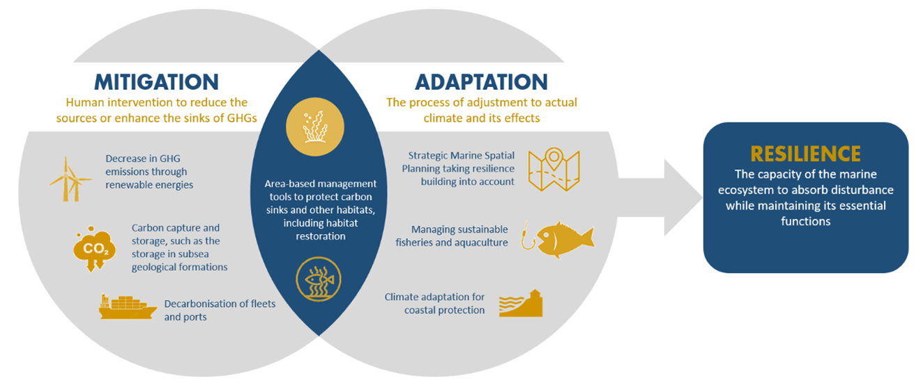
Climate Change & Ocean Acidification in OSPAR QSR 2023
Responding to the climate emergency: mitigation, resilience, and adaptation
To date, no specific OSPAR measures to mitigate or adapt to climate change or to increase resilience are in place, although the NEAES 2030 has outlined an ambitious strategy […] intended to make significant progress on climate change and ocean acidification.
Areas of opportunity for mitigation include offshore renewable energy, carbon capture and storage and protection and restoration of natural carbon stores. Through effective management of marine space and of human pressures on the marine ecosystem, the OSPAR Contracting Parties may be able to support adaptation to climate change and enhance the resilience of the marine ecosystem.
Notes:
The development of the programme of measures will continue under the NEAES 2030

Slide 11
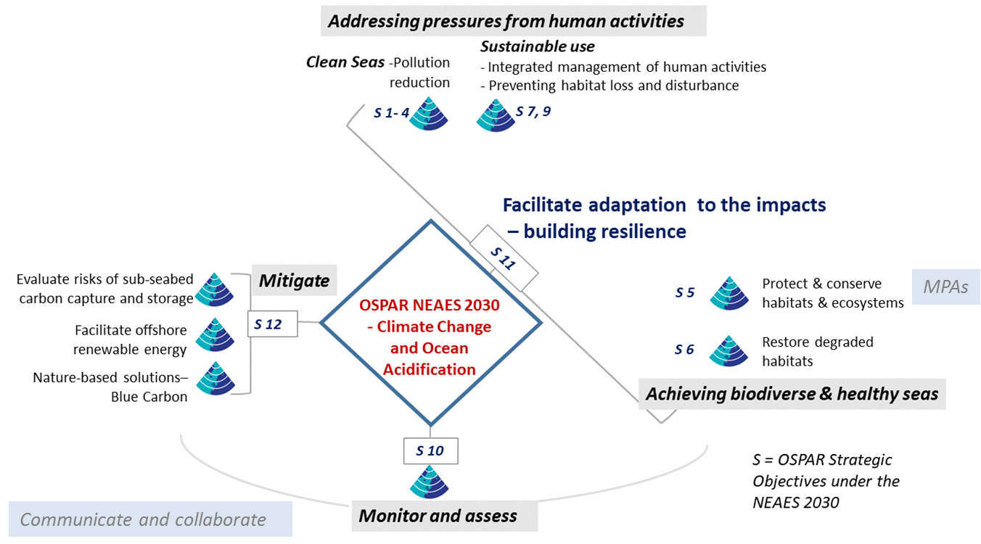
North-East Atlantic Environment Strategy (NEAES) 2030

