Slide 1
OSPAR's Quality Status Report 2023
[Name]
[Date]
[Event]

Slide 2
OSPAR’s Quality Status Report (QSR) 2023 in a nutshell
Main objective
To provide the most comprehensive and up-to-date assessment of the status of the North-East Atlantic for the period 2009-2021 and increase our knowledge and understanding of the marine environment through OSPAR’s monitoring and assessment process.
Looking both at the current state of the marine environment and ecosystems, and at human activities benefiting from the marine environment and interacting with it.

Slide 3
The QSR 2023 in a nutshell
Why?
To provide the necessary scientific knowledge to identify the priority elements for actions to achieve OSPAR’s vision of a clean, healthy and biologically diverse North-East Atlantic Ocean, which is productive, used sustainably and resilient to climate change and ocean acidification.

Slide 4
The QSR 2023 in a nutshell
16 Contracting Parties to the OSPAR Convention
more than 400 experts
64 OSPAR Observer organisations
OSPAR Secretariat
Notes:
The QSR 2023 is an ambitious collective endeavour involving the whole OSPAR network.
The 16 Contracting Parties to the OSPAR Convention are the primary contributors, nominating more than 400 experts to lead on the delivery of the various assessments which form the scientific bedrock of the QSR.
The contributions of OSPAR Observers from intergovernmental partner organisations and blue economy and environmental non-governmental organisations help to close any information gaps in data, a crucial aspect of this assessment and monitoring process.
The OSPAR Secretariat oversees the coordination of the process.

Slide 5
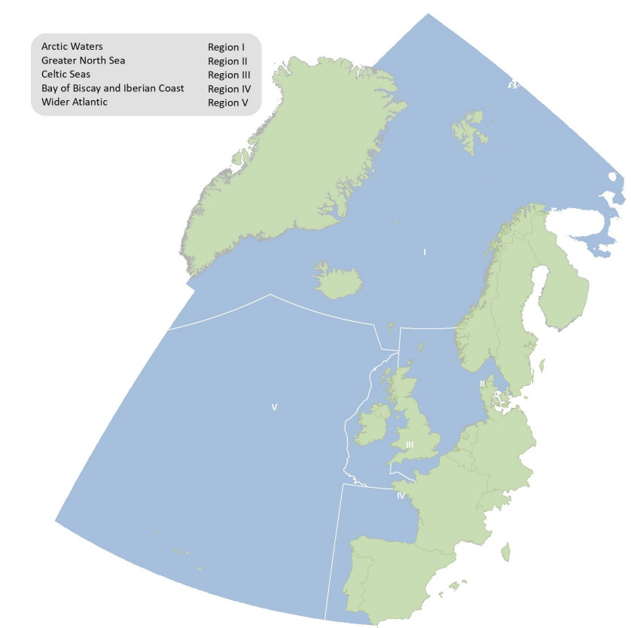
QSR 2023 Regional Scope the OSPAR Maritime Area (covering the 5 OSPAR Regions)
The North-East Atlantic
Notes:
The QSR 2023 covers the entire OSPAR maritime area.
It is recognised that data availability may limit assessments, particularly in Region I and V.
The Intermediate Assessment 2017 (IA2017) did not aim to cover the whole OSPAR maritime area, as the focus was on common indicator assessments overlapping the OSPAR maritime area that is also EU waters assessed under the EU MSFD.

Slide 6
QSR 2023 Scope - An assessment of the overall status of the marine environment in the OSPAR Maritime Area
Assessment of the status of species and ecosystems, main pressures, impacts, and evaluation of the change since QSR 2010 and IA2017
Evaluation of the impacts of climate change & ocean acidification
Identification and review of new and emerging issues.

Slide 7
QSR 2023 - Temporal scope
Quality Status Report 2010
2009-2021
The assessment period for QSR 2023 explores changes since QSR 2010
The Intermediate Assessment 2017
2015-2021
The second assessment period corresponds to the period in the 3rd EU MSFD Article 8 reporting round
Notes:
The following is recognised and accepted:
Both or either period (2009-2021/2015-2021) can be assessed, it is dependent on many factors which is possible
The availability of data and the temporal coverage of data will vary between assessments
For some assessments it will be possible to compare to an assessment carried out in QSR 2010, for other assessments the first comparable assessment was made in IA 2017
For some assessments historical trend data need to be included in the assessment in order to interpret the result
There is no need to include one data point for each year in the period, nor is there a requirement to include a datapoint from the year 2021, expert judgement is needed to determine what datapoints are needed to assess the period

Slide 8
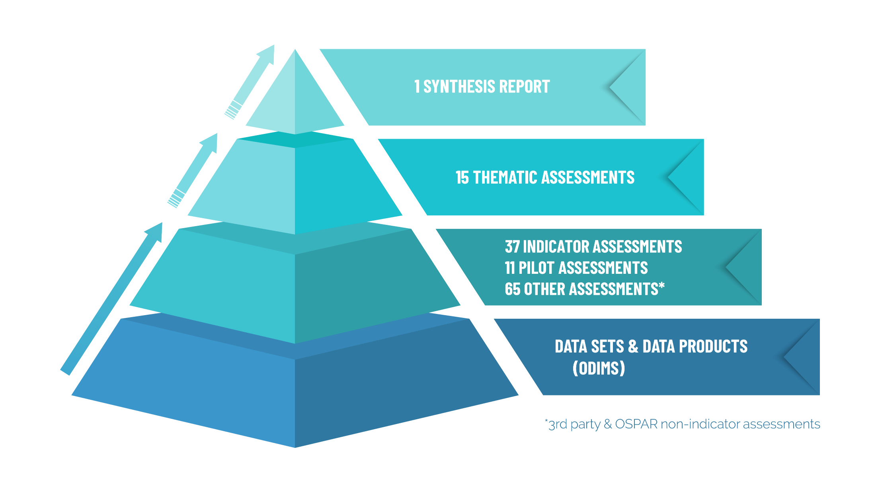
QSR 2023 Structure & Components
120 + assessments
Notes:
The QSR 2023 will consist of
1 high-level synthesis report (70-100 pages),
15 thematic assessments that synthesise per topic (ca 20-30 pages)
30-40 common indicator assessments
30-50 other assessments
and many data sets and various data products (made available through ODIMS)
The products are presented in a pyramid that should be read BOTTOM-UP. The QSR 2023 will build on the regular data collection and assessment processes that are ongoing in OSPAR, some extra data sets will also be collected. The available material will be synthesised in a first step towards a thematic assessment, and then in a second step to the synthesis report.

Slide 9
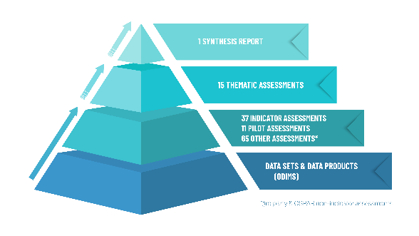
Thematic assessment
Better understand the big picture, factor in socioeconomic aspects when assessing the state of the marine environment in the North-East Atlantic and avoid siloed assessments
Implement the ecosystem approach, based on the DAPSIR, a holistic conceptual framework
Biodiversity focussed, pressure focussed, or cross-cutting (such as climate change)
Delivered as an online product + a summarised version available as PDF

Slide 10
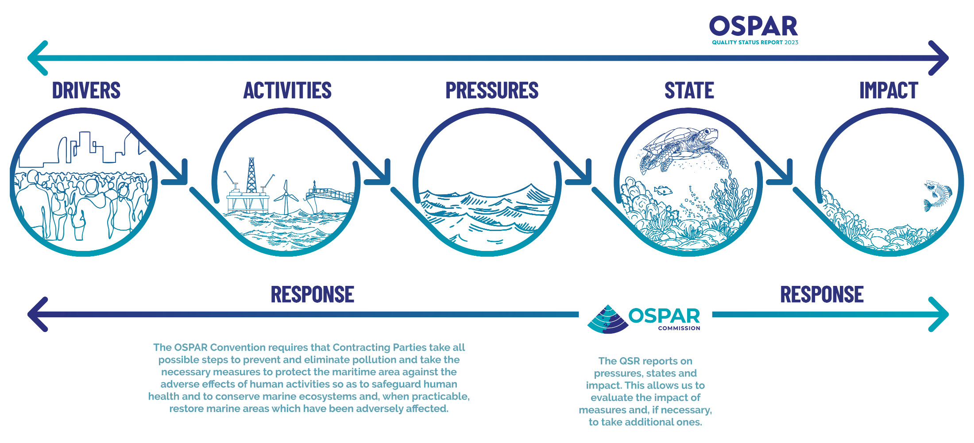
Thematic assessment – DAPSIR

Slide 11
Assessing cumulative effects in thematic assessments
Objective: To assess whether the collective pressure from human activities are within levels compatible with achieving OSPAR desired quality status outcomes, through application of the ecosystem approach.
All thematic assessments have cumulative effect section.
5 biodiversity thematic assessments include Weighted Bow Tie Analyses (Sankey Diagrams). This is an indicative assessment of cumulative effects to identify those activities and pressures of greatest concern (and meriting priority action).

Slide 12
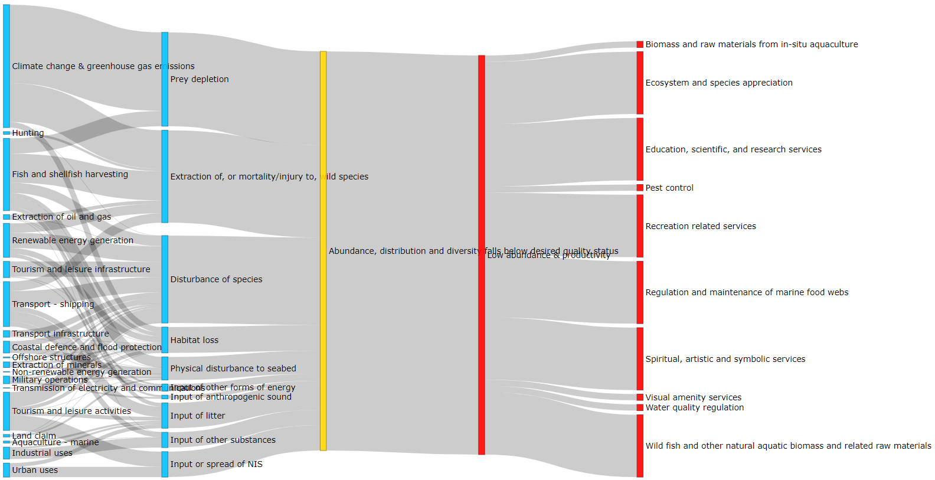
Example: Marine birds thematic assessment (weighted bow tie / Sankey plot)
North-East Atlantic Scale
Confidence:
Evidence – Medium
Consensus – High

Slide 13
More info on our website
www.ospar.org
secretariat@ospar.org
Notes:
Always refer to the QSR 2023 Guidance Document (Agreement 2019-02) for steer on process, content, responsibilities and more!
This document is the first point of call with any query on QSR matters. It describes everything from roles and responsibilities among OSPAR subsidiary bodies, to the technical categories to be applied in confidence assessments.

