Slide 1
OSPAR’s Quality Status Report 2023
Event
Date
Name
Position

Slide 2
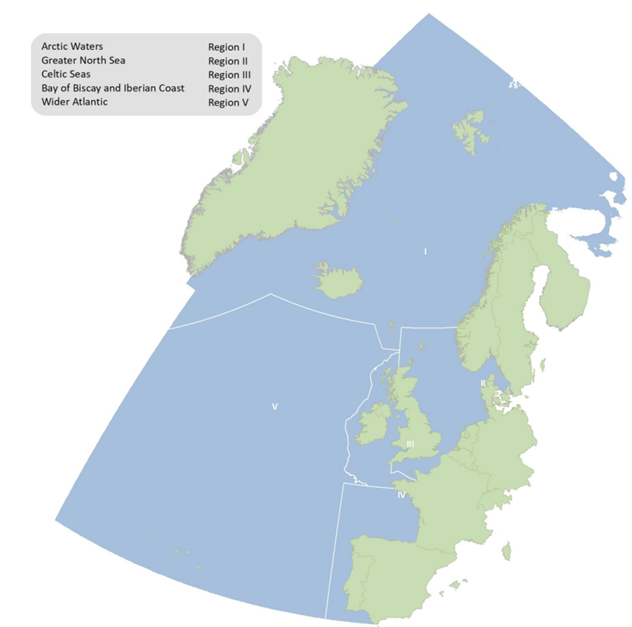
What is OSPAR?
Regional Sea Convention for the North-East Atlantic
16 Contracting Parties
Mandate to protect and conserve while using resources sustainably
Collaboration and coordination

Slide 3
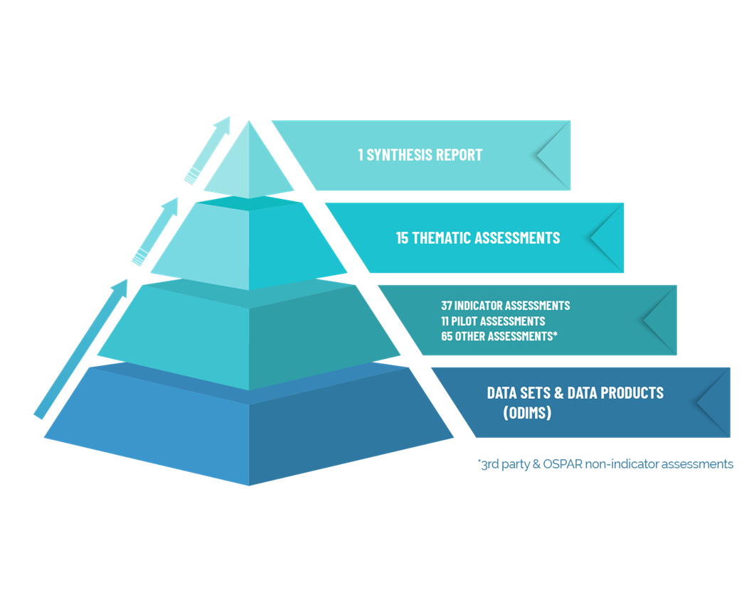
What is the OSPAR Quality Status Report 2023?
Health check for the marine environment of North-East Atlantic and the human activities that effect it

Slide 4
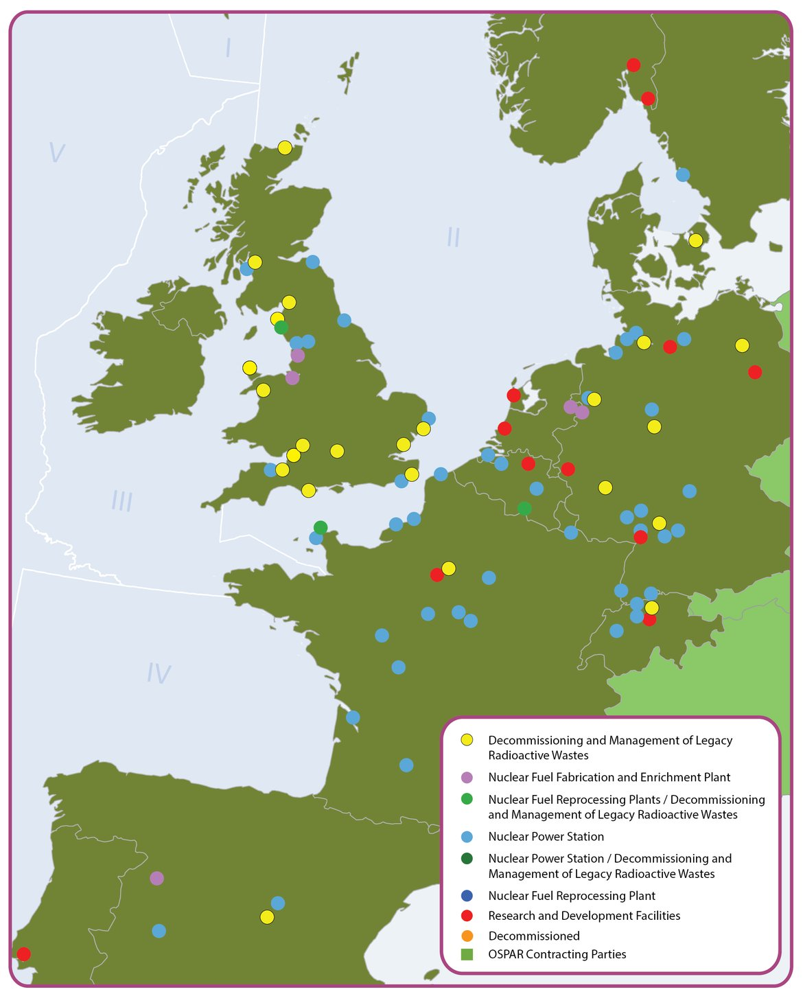
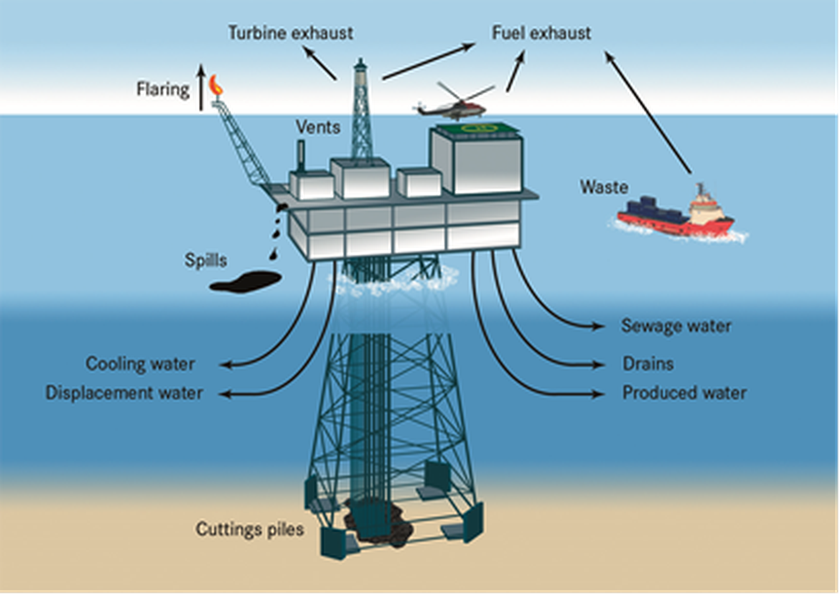
Key findings: human activities
Negative impacts from oil & gas continue to decrease
Pollution by radioactive substances prevented

Slide 5
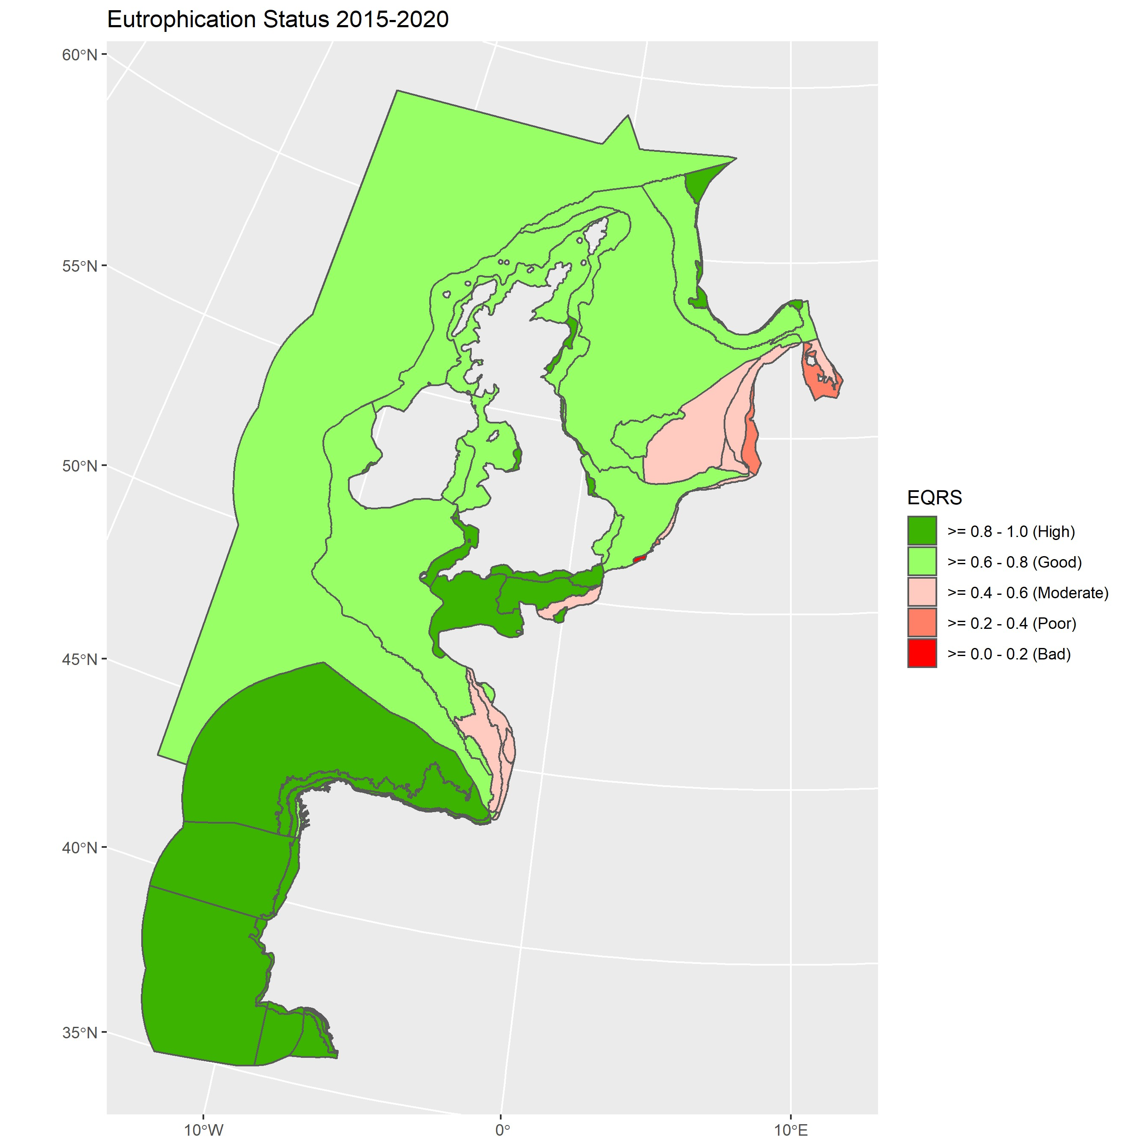
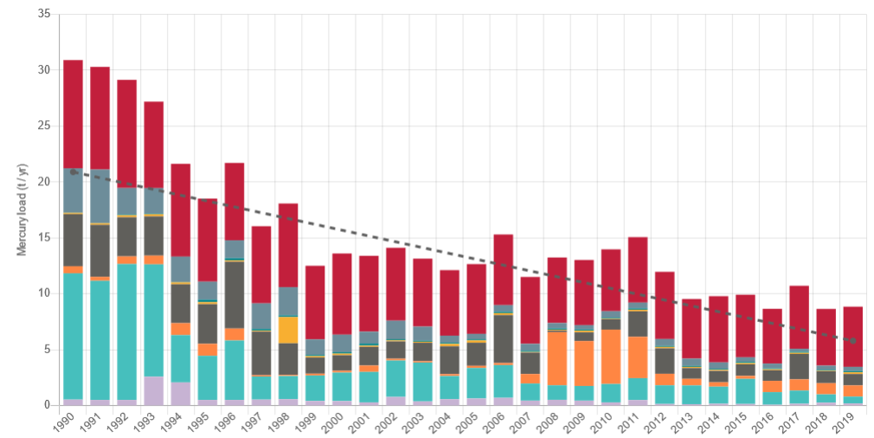
Key findings: human activities
Hazardous substances are cause for concern
Eutrophication persists

Slide 6
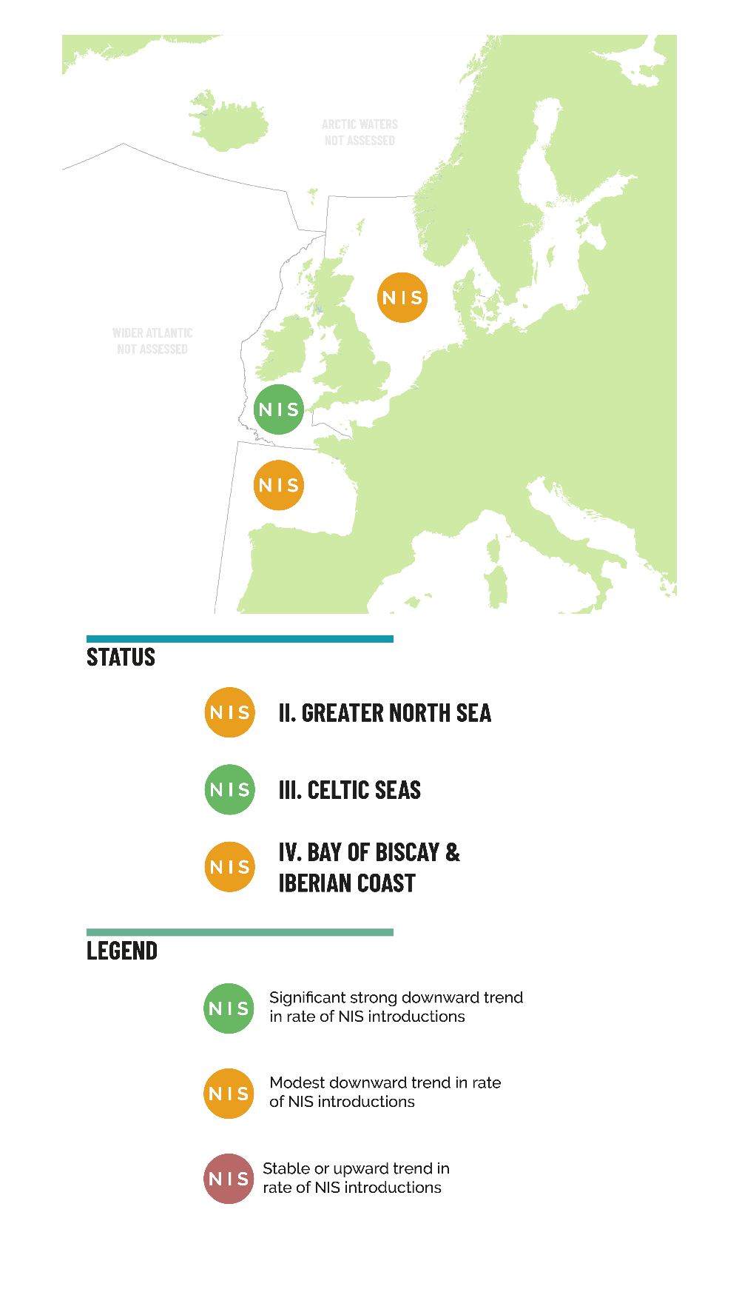
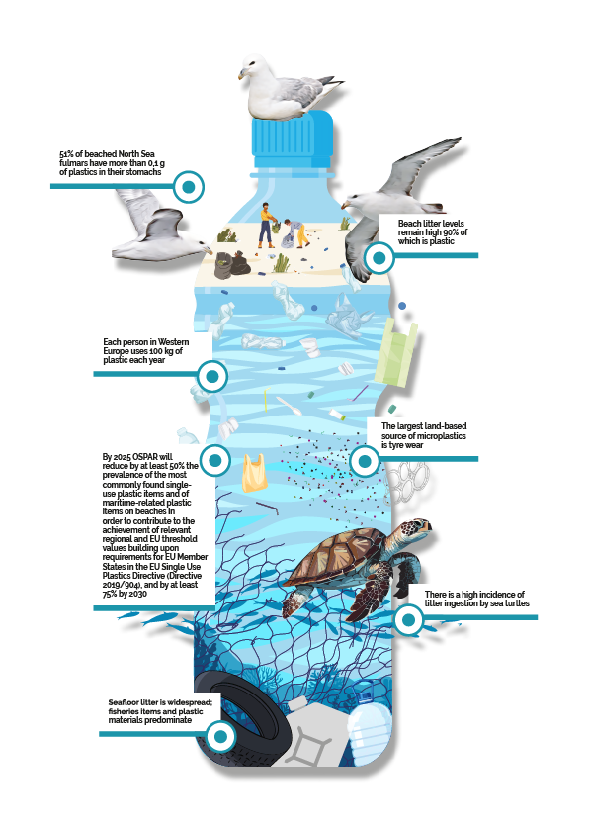
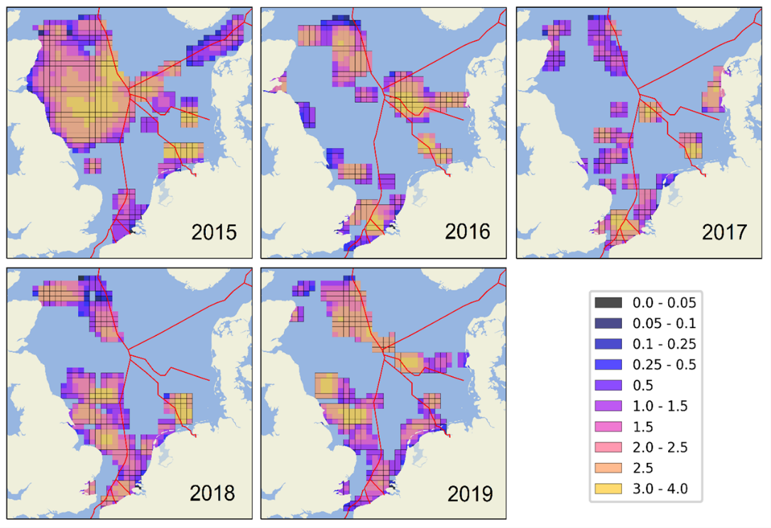
Key findings: human activities
Noise pollution remains a threat
Marine litter levels remain high
Introductions of Non-indigenous species have decreased

Slide 7
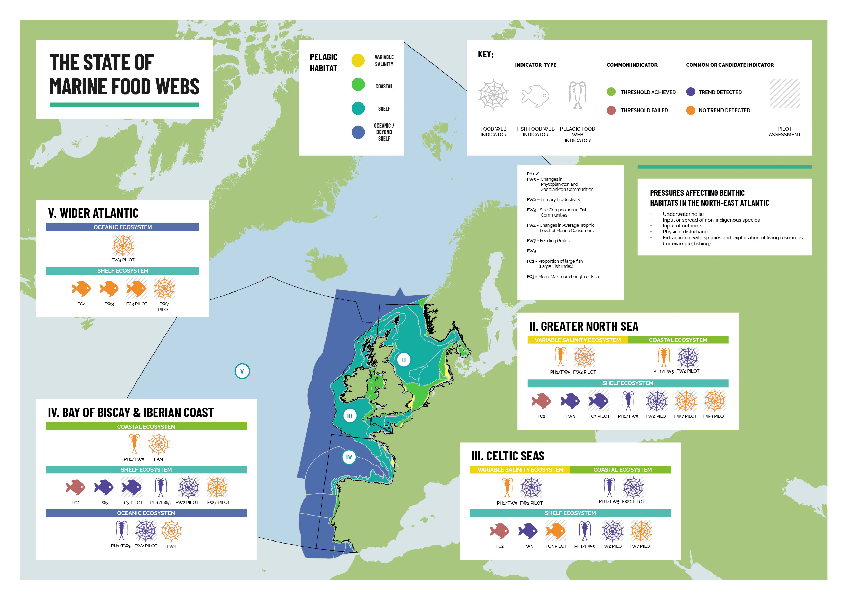
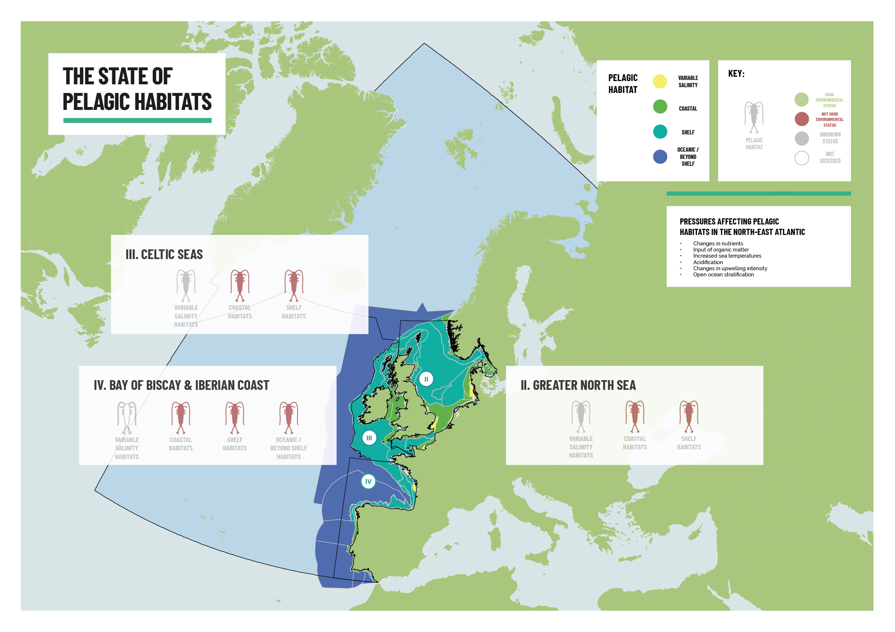
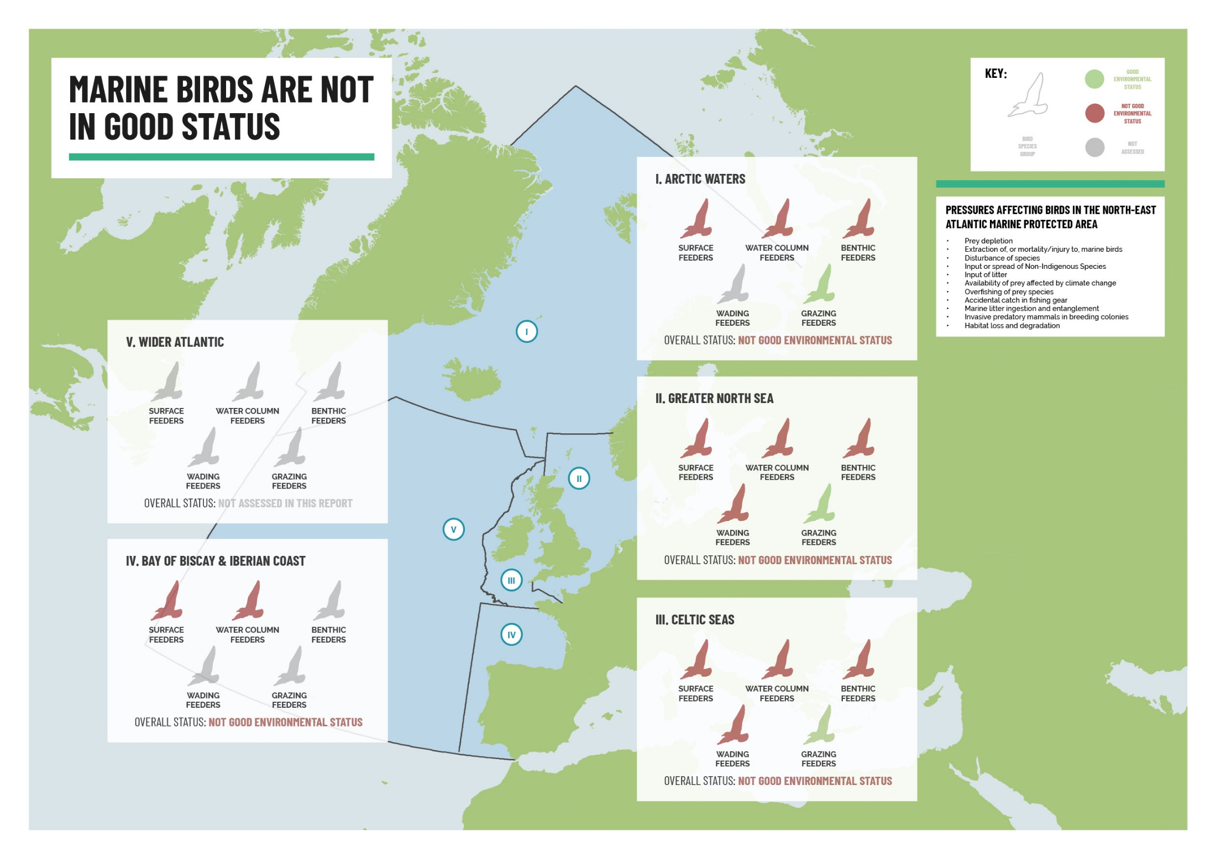
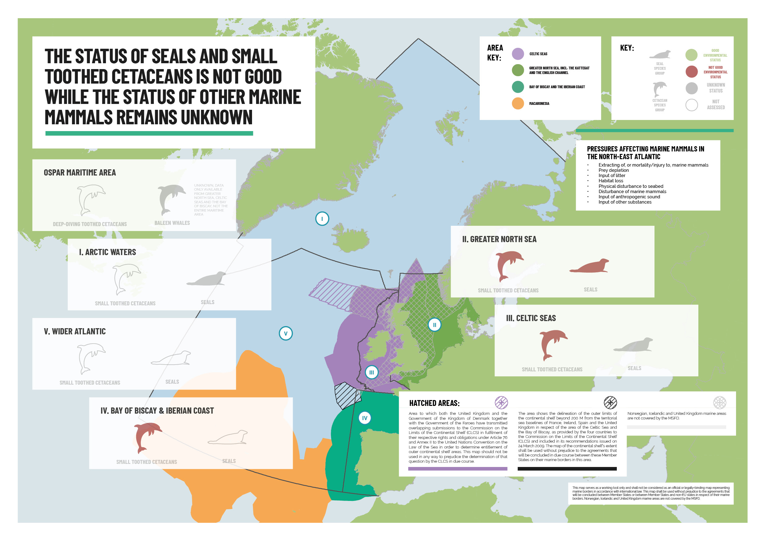
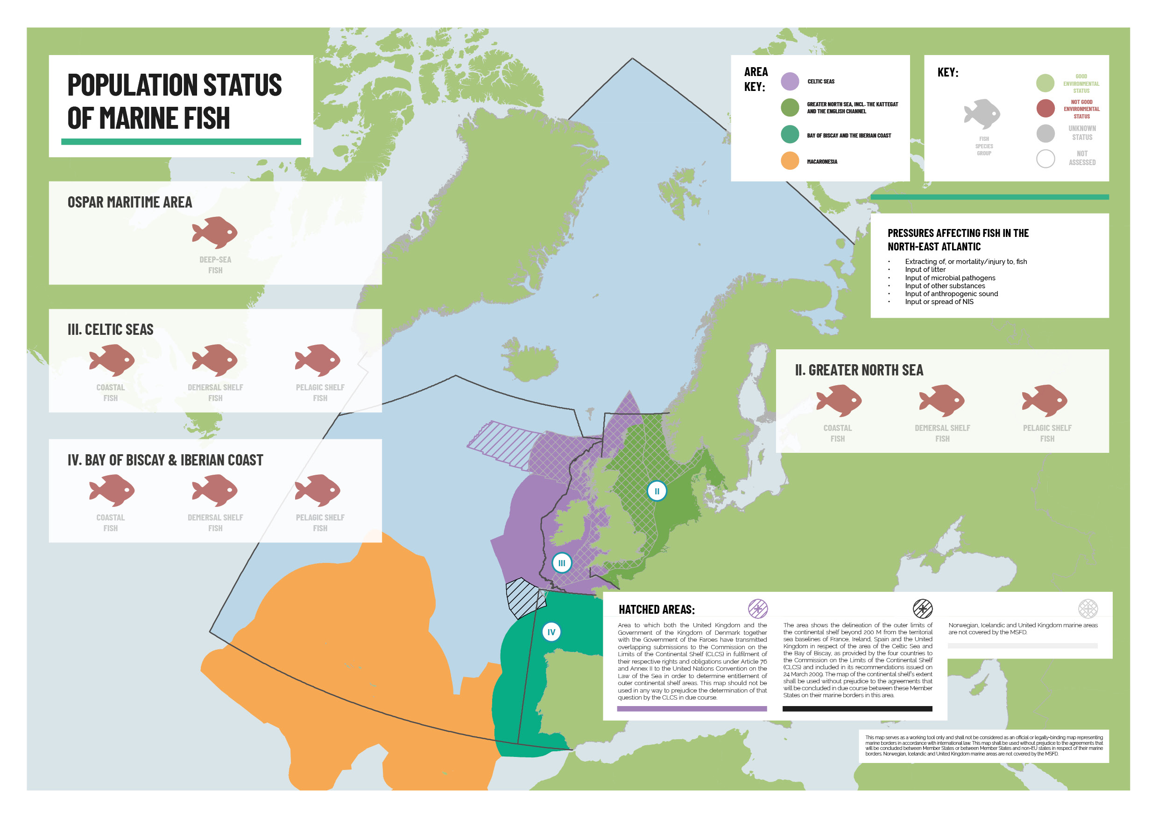
Key findings: The status of biodiversity in the North-East Atlantic

Slide 8
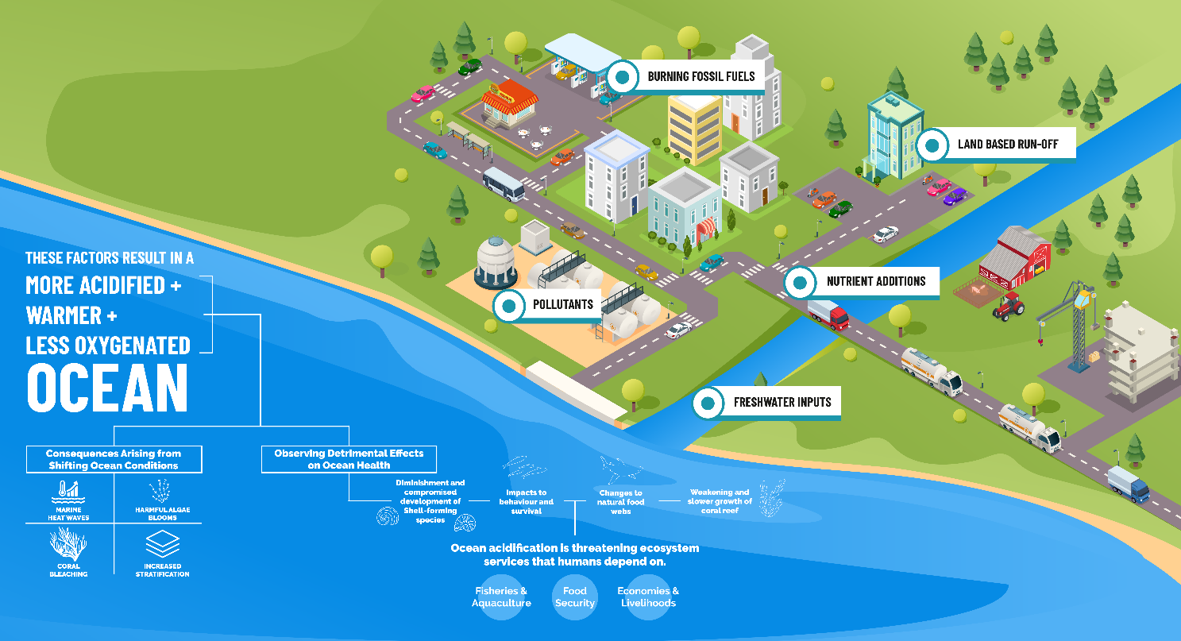
Key findings: climate change and ocean acidification
The impacts of climate change are clearly measurable
Ocean acidification puts ecosystems at further risk

Slide 9
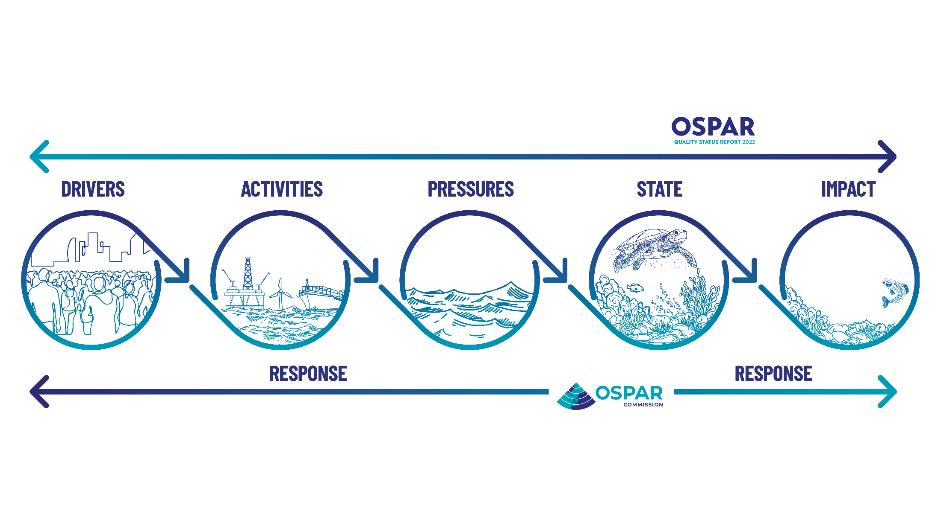
Science driving policy

Slide 10
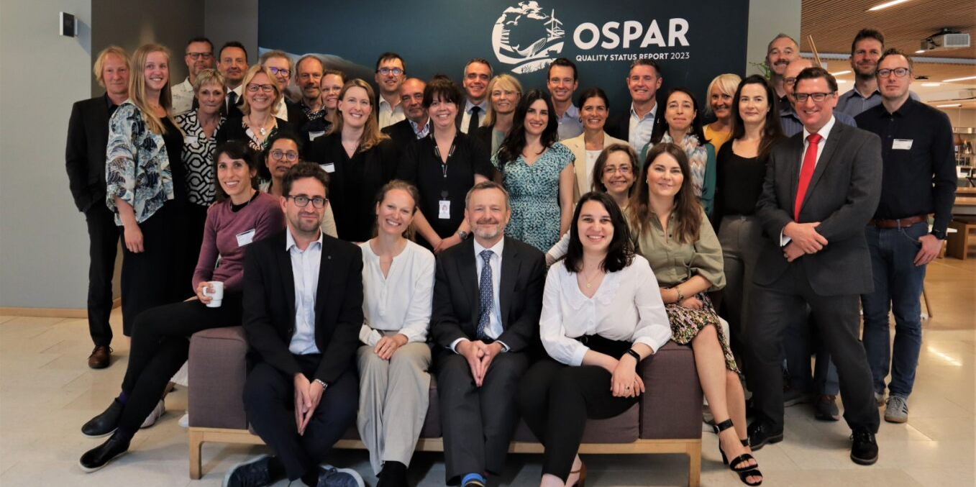
What happens next?
Identify gaps – knowledge, research, monitoring, effectiveness
Evidence based policy – where is it working, where is more it not?
Political commitment – Ministerial review of OSPAR 2030 strategy

Slide 11
Thank you
www.ospar.org
secretariat@ospar.org
Notes:
Always refer to the QSR 2023 Guidance Document (Agreement 2019-02) for steer on process, content, responsibilities and more!
This document is the first point of call with any query on QSR matters. It describes everything from roles and responsibilities among OSPAR subsidiary bodies, to the technical categories to be applied in confidence assessments.

